Slide 1
IBCOL 2020

Slide 2
IBCOL 2020 Brief Timeline
Training Programme
Mid September 2019
End of April 2020
Submission
HK-BCOL
(Regionals)
IBCOL 2020
Jan 2020
May 2020
June 2020
July 2020
2

Slide 3
Training Courses Overview
BASIC
ADVANCED
DEVELOPER
Certified Blockchain Professional - Basics
Certified Blockchain Professional - Advanced
Certified Blockchain Developer
BC 101: Blockchain & Cryptography
BC 102: Blockchain Business & Legal
BC 201: Privacy & Identity
BC 202: Asset Tokenization & Digital Fiat
BC 203: Governance & Compliance
BC 204: Solutions Architecture
BC 205: Advanced Training: Fintech
BC 301: Blockchain Engineering - R3 Corda
BC 302: Blockchain Engineering - HL Fabric
After these courses, you would be able to build your own impactful and lasting decentralised applications
3

Slide 4
Eligibility
Up to 6 students can register into one team
A team can submit more than one project
Each project is entered into a category
4

Slide 5
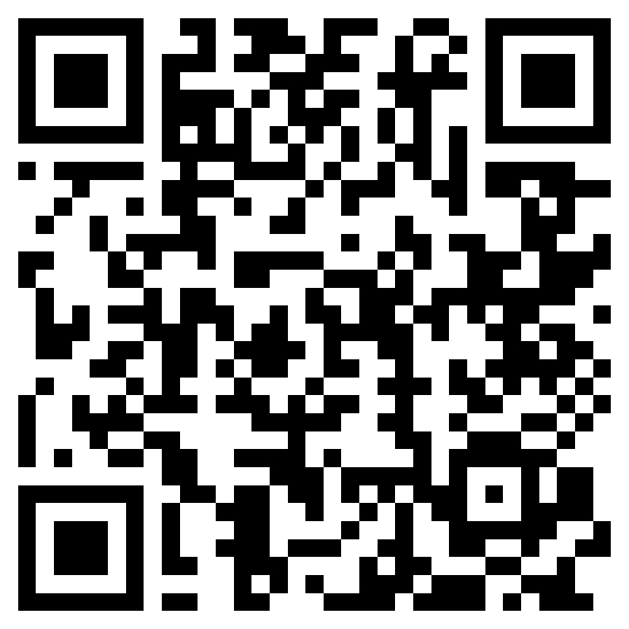
Contact
Whatsapp group
Enroll the courses on: www.ibcol.org
Join us on: www.ibcol.org/join-us
5

Slide 6
Contact
Wechat group
Enroll the courses on: www.ibcol.org
Join us on: www.ibcol.org/join-us
6

